Slide 1
Design Evaluation
Software Metrics Exercises

Slide 2
Software Metrics Calculation
IntelliJ – MetricsReloaded, MetricsTree, CodeMetrics, or similar plugin (installation)
File | Settings → Plugins → Marketplace
search for wanted plugin (e.g., ‘MetricsReloaded’)
install
analyze and calculated metrics and browse through calculated metrics values

Slide 3
Software Metrics Calculation
IntelliJ – MetricsReloaded plugin (metrics calculation)
Help | Find Action… → search Calculate Metrics …
select scope
whole project / file / custom
select metrics
Chidamber-Kemerer (CK) metrics
Class count metrics
Complexity metrics
Dependency metrics
Junit testing metrics
Javadoc coverage metrics
Lines of code metrics
MOOD metrics
Martin packaging metrics
Number of files metrics

Slide 4
Software Metrics Calculation
Eclipse – Metrics plugin 1.3.8 (installation)
Help | Install New Software …
add repository
URL: http://metrics2.sourceforge.net/update/
Install & restart

Slide 5
Software Metrics Calculation
Eclipse – Metrics plugin 1.3.8 (metrics calculation)
Windows → Show View → Other
select a project for which you want to calculate metrics
select ’Metrics View’ from ‘Metrics’
browse through calculated metrics values

Slide 6
Software Metrics Calculation
examples from lecture slides :
draw control flow graph for the following and calculate Cyclomatic Complexity (CC) :
BinarySearch.java

Slide 7
Software Metrics Calculation
Design Evaluation Exercises
calculate cohesion metrics for the followings:
a₁
a₁
m₁
a₂
m₁
a₂
m₂
a₃
m₂
a₃
m₃
a₄
m₃
a₄
a₅
a₅
LCOM =
LCOM2 =
LCOM-HS =
LCOM =
LCOM2 =
LCOM-HS =

Slide 8
Software Metrics Calculation
Design Evaluation Exercises – Video Rental System
use standalone tools or IDE plug-ins to calculate Complexity and C&K(Chidamber & Kemerer) metrics for the followings :
Customer.java, Rental.java, Video.java, VRUI.java
analyse the calculated/derived metrics values :
provide a short summary and thoughts on analysis results :

Slide 9
Architecture Analysis & Evaluation
STAN4J Exercises

Slide 10
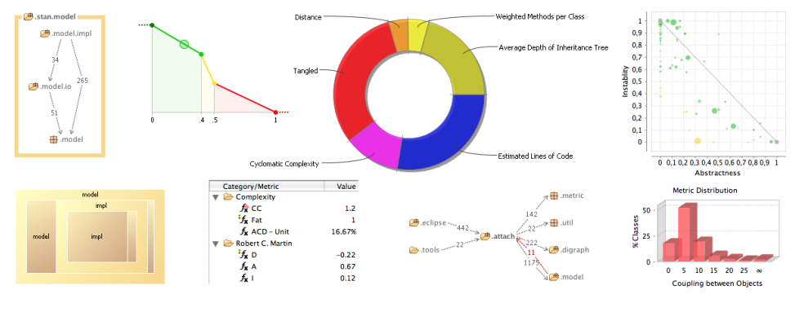
Architecture Analysis – STAN4J
Java Architecture Analysis & Evaluation Tool
visualising design
understanding code
measuring quality
reporting design flaw

Slide 11
Architecture Analysis – STAN4J
Eclipse – STAN4J plugin (installation)
Help | Install New Software …
add repository
Name : STAN Tycho Repo
URL : http://update.stan4j.com/ide
Install and restart
Eclipse – STAN4J plugin (Architecture Analysis)
from context menu on project where architecture to be analysed are located → Run As → Structure Analysis

Slide 12
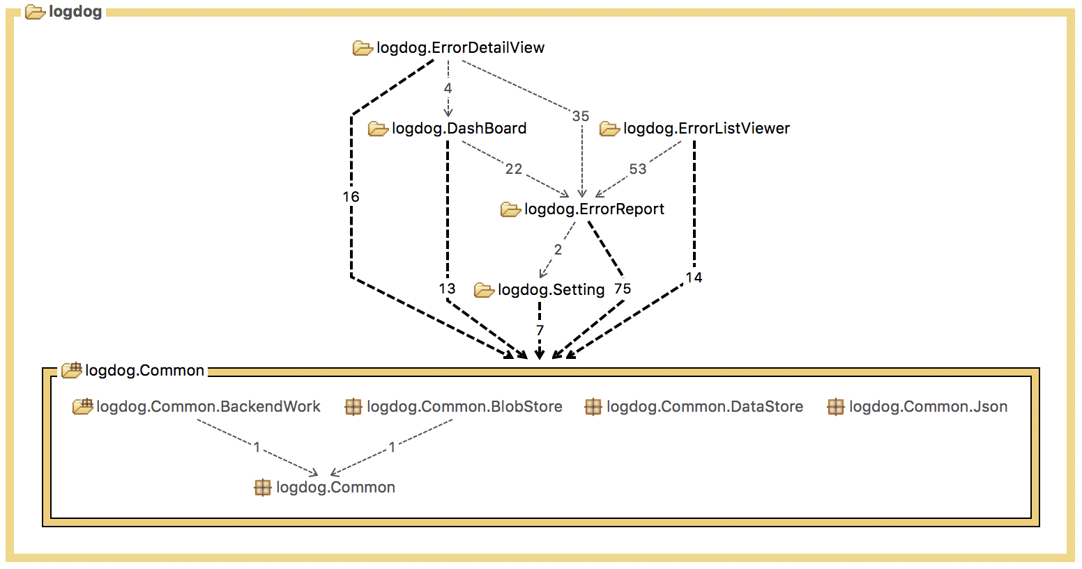
STAN4J - Dependency Graph
composition view
dependencies between classes, packages, …

Slide 13
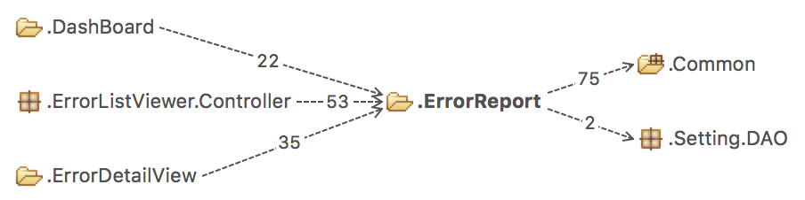
STAN4J - Dependency Graph
Coupling
left : packages that depends on the selected package
right : packages that the selected package depends on

Slide 14
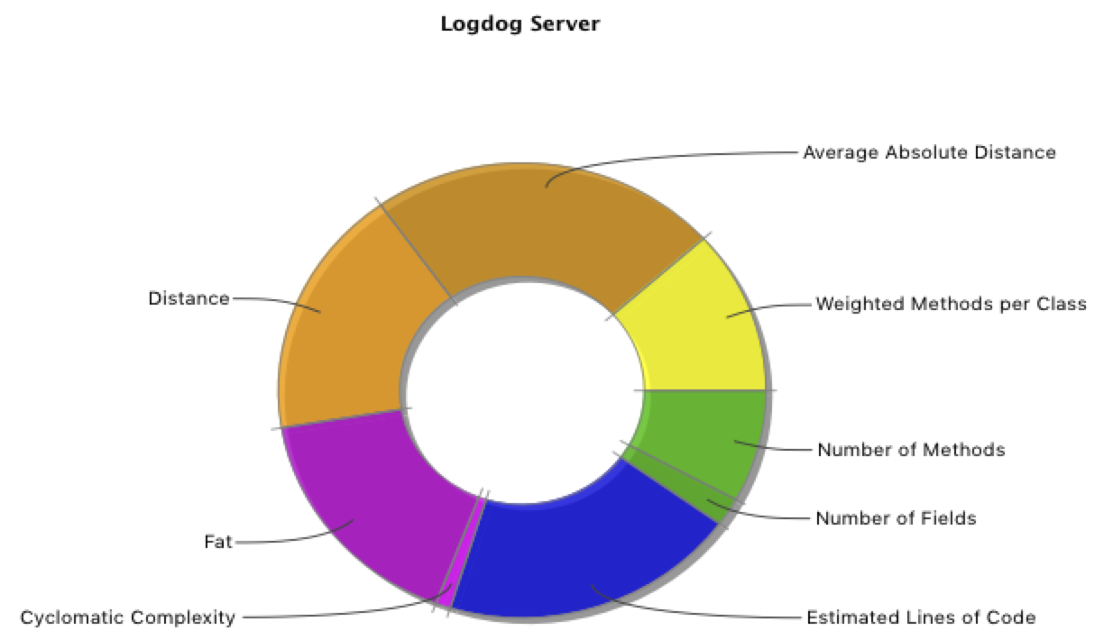
STAN4J - Pollution
abnormal metric values is expressed in Pollution
according to STAN4J’s own standard

Slide 15
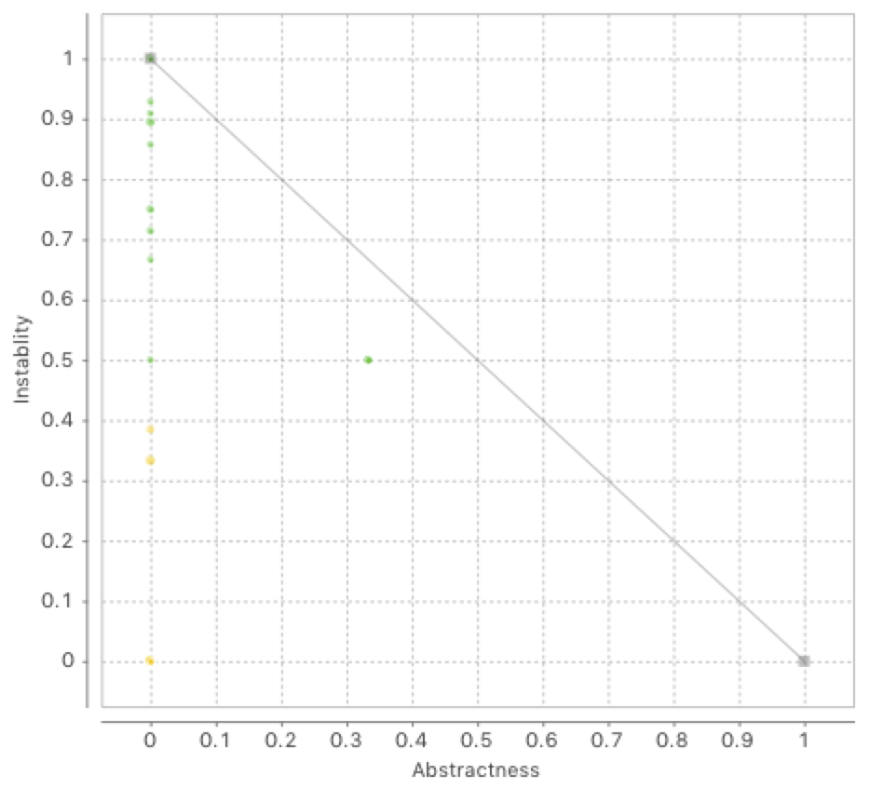
STAN4J - Distance
normalized distance from main sequence
from Robert C. Martin metrics

Slide 16
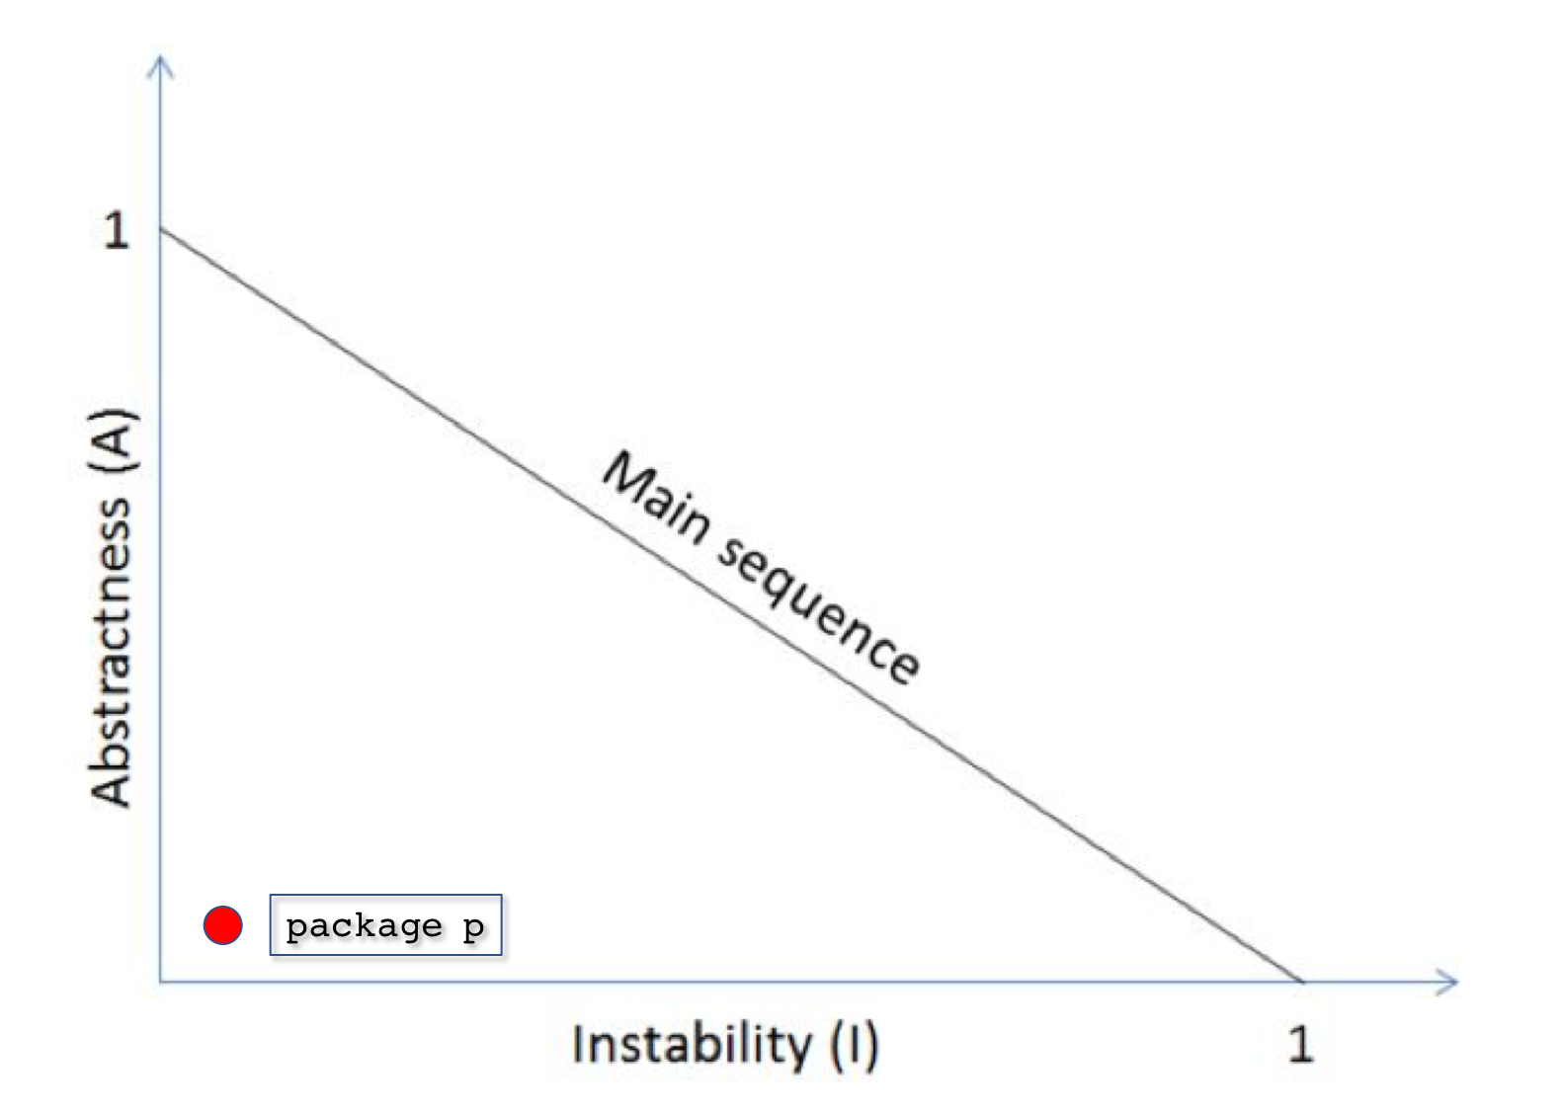
STAN4J – Architecture Analysis Exercise
interpret the plot (package p) on below Main Sequence of Robert C. Martin metrics in terms of instability and abstractness :
describe potential problems of package p (plot) and possible fix for the found problem :

Slide 17
STAN4J – Architecture Analysis Exercise
select any complex Java application (from online or from working project) and download its source code :
state the name of the selected application
analyse its architecture using STAN4J
provide a short summary and thoughts on analysis results :

Slide 18
Design Evaluation : Submission
things to submit :
calculated LCOM, LCOM2, LCOM-HS for 2 diagram (slide 7)
calculated Complexity and C&K metrics for Video Rental System + short summary and thoughts after analyzing the metrics values calculated for Video Rental System (slide 8)
interpretation of the plotted package p in terms of instability and abstractness + description of potential problems and possible fix for the package p (slide 16)
short summary and thoughts after analyzing architecture of the selected complex Java application using STAN4J (slide 17)

